Slide 1


Data Structure
Dr Shahjad
Faculty
School of Engineering & Technology
K.R. Mangalam University
Unit 3: Sorting and Searching
Dr. Shahjad

Slide 2


Hash Table
Understanding the concept of Hash Tables
Learning how to store and access elements using a hash function
Examples of Hash Table creation and usage
Algorithm of Hash Table operations and their applications
Complexity analysis of Hash Table operations (search, insert, delete)
Brainstorming session on designing efficient hash functions

Slide 3
Introduction to Hash Table
A hash table is a data structure that stores key-value pairs, allowing for efficient insertion, deletion, and retrieval of data.
It operates on the principle of hashing, where a hash function maps keys to indices in an underlying array, often referred to as buckets or slots.

Slide 4
Introduction to Hash Table..
Key: Unique identifier for data.
Value: Data associated with the key.
Hash Function: A function that converts the key into an array index.
Goal: To achieve fast insertion, deletion, and lookup — ideally in O(1) average time.

Slide 5

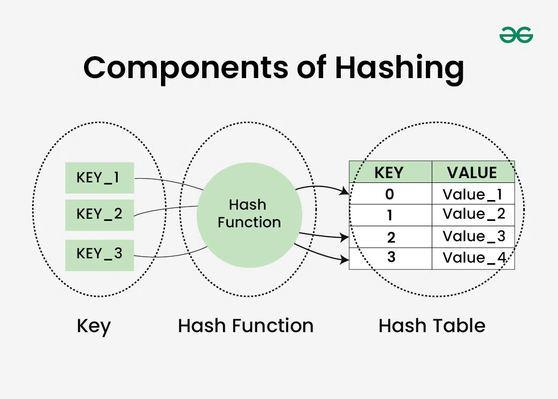
Working of Hash Functions?

Slide 6

How a Hash Table Works
Take the key (e.g., a number, string, or object).
Apply a hash function to get a numeric value (hash code).
Map the hash code to an index in the table (usually with modulo operation).
Store the value at that index.

Slide 7
What is Load factor?
A hash table's load factor is determined by how many elements are kept there in relation to how big the table is.
The table may be cluttered and have longer search times and collisions if the load factor is high.
An ideal load factor can be maintained with the use of a good hash function and proper table resizing.

Slide 8
Advantages & Disadvantages
Fast Access: Average O(1) operations.
Efficient Storage: Stores only keys and values needed.
Flexible Key Types: Numbers, strings, custom objects.
Disadvantages
Collisions are unavoidable.
Performance Degrades when the table becomes too full (high load factor).
Requires good hash function design.

Slide 9
Example
Example 1 – Simple Hash Table with Chaining
Table size: 10 Keys: {32, 45, 62, 97} Hash Function: h(k) = k % 10
Step | Key | Hash | Index | Action
1 | 32 | 2 | 2 | Place at index 2
2 | 45 | 5 | 5 | Place at index 5
3 | 62 | 2 | 2 | Collision → chain at 2
4 | 97 | 7 | 7 | Place at index 7
Unit2

Slide 10
Example 2 – Open Addressing
Example 2 – Open Addressing (Linear Probing)
Table size: 7 Keys: {50, 700, 76, 85, 92} Hash Function: h(k) = k % 7
Step | Key | Hash | Index | Action
1 | 50 | 1 | 1 | Place at index 1
2 | 700 | 0 | 0 | Place at index 0
3 | 76 | 6 | 6 | Place at index 6
4 | 85 | 1 | 1 | Collision → next = index 2
5 | 92 | 1 | 1 | Collision → index 2 full → index 3

Slide 11
Example 3 – String Keys
Example 3 – String Keys
Hashing is not just for numbers.
Hash Function: Sum of ASCII codes % table size.
Table size: 10 Keys: {"CAT", "DOG", "BEE"}
"CAT" → (67 + 65 + 84) = 216 → 216 % 10 = 6
"DOG" → (68 + 79 + 71) = 218 → 218 % 10 = 8
"BEE" → (66 + 69 + 69) = 204 → 204 % 10 = 4
Unit2

